Slide 1
Team Heatwaves
Presentation on College Management System

Slide 2
The Creative Team
Meet The Team
Kolade Moses
Samuel Oluwole
Dosunmu Olufolatomi
Assistant Team Leader
Team Member
Team Member
Sunday Aspita
Oyawe Goodness
Owolabi Blessing
Oladele Idowu
Team Leader
Team Member
Team Member
Team Member

Slide 3

About The Team
About us
This is Our Goal
We are a team consisting of 9 members whom all have same goals for the College Management System project which allows new students and new staffs to submit their records, so it can saved and recorded into the database.
Innovative
Everyone here works hard to get the program running. Good research always be our priority, cause good research makes the better team and gives more respect to us. It will make them believe we were professional team. Enjoyment and fun, those are things must we do when we work.

Slide 4
About the Project
What We’ve Done
About Project
You have gotten admission to your desired school and what’s next you need to submit your information to school ,how do you do that?
That is where our software comes in .
It makes it easier for storing and retrieval of records by both staff and student .
Project Client
Mr. Ayodeji Ibitoye

Slide 5
What are the contents of this Presentation
Our Service
01
02
03
04
Introduction
Scope
Objectives/Aim
Benefits
What is College Management System
Scope of the Program
Objectives/Aims of the Program
Benefits of the Program
05
06
Implementation
Limitations
Implementation of the Program
Limitations of the Program

Slide 6
Introduction
What is College Management System?
You have gotten admission to your desired school and what’s next you need to submit your information to school ,how do you do that?
That is where our software comes in.
It makes it easier for storing and retrieval of records by both staff and student .

Slide 7
02. Scope
College management system is basically manufactured to compile all the manual activities of administrative importance in the form of a software. This software further makes it easier for officials to finish off their work in a lesser span of time. Most of all, the mechanism of software is easy to understand that even if any school is utilizing it for the first time, the users will not have to toil hard to learn its function.

Slide 8
03. Objectives/Aims
To take in students input.
To save students records.
To be able to search through students record.
Retrieve a student record.
The above objectives for lecturers also.
And be properly pass-worded to restrict use .

Slide 9
04. Benefits
1. You save time.
The objective of establishing a school management system is to accomplish a more organized and efficient process to run your school. The School Management System audits your resources to help you formulate intelligent solutions to implement and address various challenges.
2. You communicate in real-time.
Connectivity has been one of the most important aspects of management in any type of industry, more so in schools wherein, various stakeholders are concerned. Certain Student Information System allows various departments and campuses to communicate in real-time, making for more systematic collaborations within an integrated platform.

Slide 10
04. Benefits
3. You make data-driven decisions.
School management systems are designed to address your school’s various needs while streamlining various processes. This allows you to make smarter decisions as data generation in student information, faculty and staff rosters, timetables, exam schedules, technical reports, and even fees and profits, proves to be faster and more accurate.
4. You save money.
Another significant advantage in utilizing school management systems is how it improves your offer for quality education, without having to augment your cost parameters. With proper assessment prior to the installation of a school management system, all core business processes are geared towards productivity. One of the ways you could use the School Management System would be automating and digitizing your registration process by arranging it online rather than allotting expenses for physical procedures.
5. You evolve with technology.
Technological advancements have influenced schools to take a leap towards progress and success. School Management Systems not only eases the administrative processes but also ensures the efficiency of the schools. It allows for an effective way of storage and distribution of information.

Slide 11
05. Implementation
We made use of DEV-C++ application as the IDE, hence the code is written in C++ language
We had to engage in strict research to get required functions and headers needed.
We entered creation and modification stage for the code
Made use of comments along the way to remember the use of the functions and variable names.
After which we tried out a GUI for it, a very difficult task because there wasn’t any useful material to the scope of our project both online and in the books so we managed what we can by using the RAD Studio C++ Builder to create a graphical user interface.

Slide 12
06. Limitations
Although good as the code is there are few limitations such as deletion and a better way of storage than a file ,but with future maintenance and more resources time and …. ,this can be achieved.
The drawbacks in Student Management System software can be counted on fingers; with mostly only benefits, these systems have a few countable downsides. Often, applications face minor technical glitches and these systems are no exception but, ratification is immediate. Only, people who are accustomed to regular use of smartphones or computers can operate this software. Extensive modules and features make it difficult for a user to utilize the application. With huge flow in traffic the application is prone to performance issues. Few companies market their products at extravagant price, which are not affordable by growing organizations. Absence of proper internet-network makes it difficult for a user to access information, which is a significant disadvantage. The risk of data mishandling might be bothersome; but all these drawbacks can be evaded by choosing proper, cost-efficient and best software that best benefits an organization.
So here are the major limitations of College Management System:
1. The college management system is prone to hacks.
2. Administration cannot edit or modify the records after the records have been inputted into the system
3. Extensive modules and features make it difficult for a user to utilize the application.
4. Minor technical glitches and issues.

Slide 13


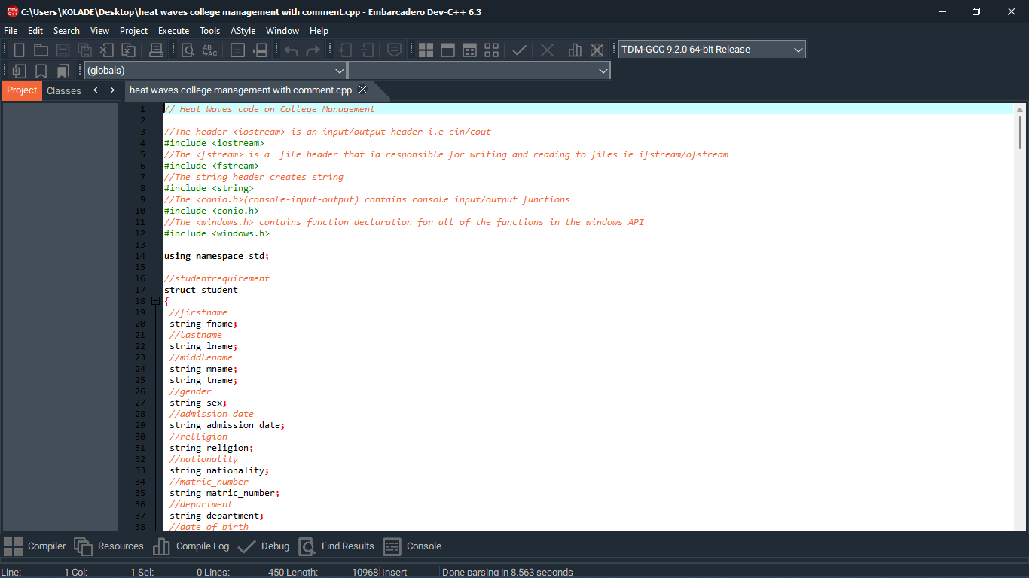
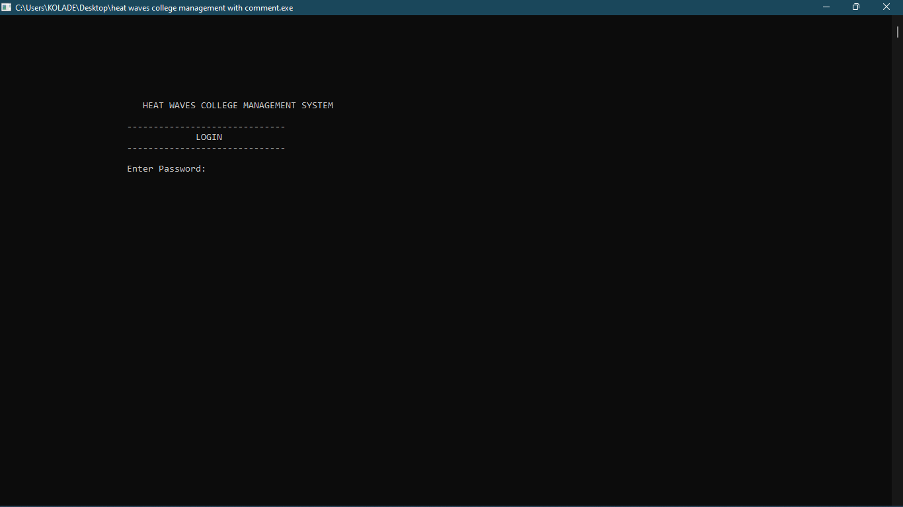
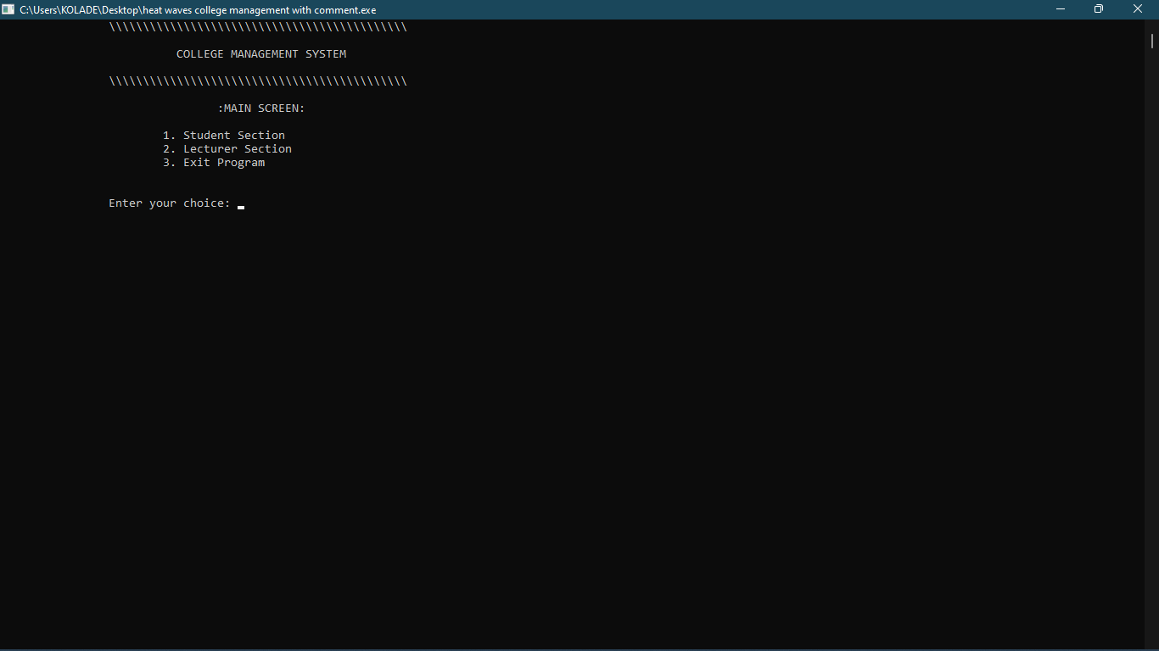
The Program
What We’ve Done

Slide 14
Conclusion
This is not the full app version, the app main app later in the future will have features such as search, delete, modify, this is a glimpse to the future.

Slide 15
How to Contact Us
Contact Us
“ In case you have a project and need us, would like to discuss and get in touch with us ”
Mailing Address
Contact Info
Social Media
Bowen University,
New Site, John Block, Room 1, Osun State, Iwo.
Phone : +6222 8796521
Fax : +6222 8291234
Email : teamheatwaves@gmail.com
Web : heatwaves.com
Facebook : TeamHeatwaves
Twitter : @teamheatwaves
Google+ : heatwaves

Slide 16
Thank You
For The Attention. Any Questions?

